Slide 1
Discrete Mathematics
Unit 2
2
Integer and Matrices

Slide 2
Discrete Structures: Syllabus
2.1 Integers (5 LH)
Integers and Division
Division Algorithm
Modular Arithmetic
Primes and Greatest Common Divisor
Extended Euclidean Algorithm
Integers and Algorithms
(Addition, Multiplication, Division & Remainder Algorithms)
Application of Number Theory
(Linear Congruencies, Chinese Remainder Theorem, Computer Arithmetic with Large Integers).

Slide 3
Division
Definition: If a and b are integers with a ≠ 0, then a divides b if there exists an integer c such that b = ac.
When a divides b we say that a is a factor or divisor of b and that b is a multiple of a.
The notation a | b denotes that a divides b.
If a | b, then b/a is an integer.
If a does not divide b, we write a ∤ b.
Example: Determine whether 3 | 7 and whether 3 | 12.

Slide 4
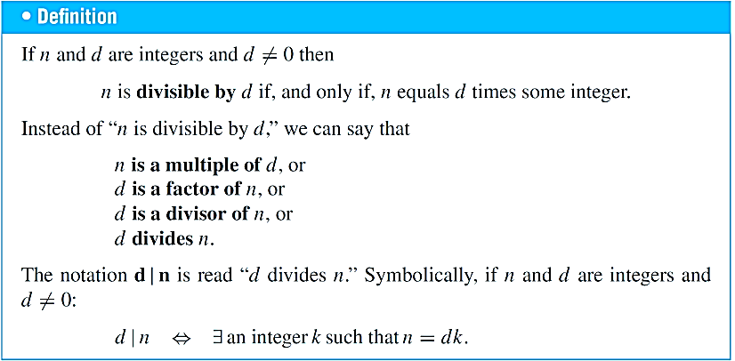

Slide 5
Properties of Divisibility
Theorem 1: Let a, b, and c be integers, where a ≠0.
If a | b and a | c, then a | (b + c);
If a | b, then a | bc for all integers c;
If a | b and b | c, then a | c.
Proof: (i) Suppose a | b and a | c, then it follows that there are integers s and t with b = as and c = at. Thus, b + c = as + at = a(s + t). Hence, a | (b + c)
(ii) Suppose a | b, then by definition divisibility, it follows that there is an integers s with b = as, Multiplying both sides by an integer c, then
bc = asc ⇒ bc = a(sc), since s and c are integer, then sc also an integer.
Thus a divides bc. i.e. a|bc
(iii) Suppose If a | b and b | c, then by definition divisibility, it follows that there is an integers s and t with b = as,
and c = bt, then c = bt = ast = a(st) , since s and t are integer.
Thus, a divides c. i.e. a|c
Corollary: If a, b, and c be integers, where a ≠0, such that a | b and a | c, then a | mb + nc
whenever m and n are integers.

Slide 6
THE DIVISION ALGORITHM
Let x be an integer and m a positive integer. Then there are unique integers q and r, with 0 ≤ r < d , such that x = m.q + r . Note: m is called the divisor, x is called the dividend, q is called the
quotient, and r is called the remainder
Remainder function (mod. m function):
Let x be any integer and m be a positive integer. Then x(mod.m) is The integer remainder When x is divided by m, x(mod.m) is the unique integer r such that, x = mq + r where o ≤ r < M, r be the remainder.
If x is negative, divide |x| by M to get the remainder r′ Then x(mod.M) =M – r′ , r′≠ 0
Example 1:
29(mod.7) =
1,
– 26 (mod.7) =
7-5 = 2
24(mod.6) =
0,
– 39(mod.3) =
3 – 0 = 3
Example 2:
If f is the mod.7 function, compute f₇(-81)
Solution:
-81(mod.7) =
7 – 4 = 3

Slide 7
Congruence Relation
Definition: If a and b are integers and m is a positive integer, then a is congruent to b modulo m if m divides a – b.
The notation a ≡ b (mod m) says that a is congruent to b modulo m.
We say that a ≡ b (mod m) is a congruence and that m is its modulus.
Two integers are congruent mod m if and only if they have the same remainder when divided by m.
If a is not congruent to b modulo m, we write
a ≢ b (mod m)
Example: Determine whether 17 is congruent to 5 modulo 6 and whether 24 and 14 are congruent modulo 6.
Solution:
17 ≡ 5 (mod 6) because 6 divides 17 − 5 = 12.
24 ≢ 14 (mod 6) since 24 − 14 = 10 is not divisible by 6.

Slide 8
More on Congruences
Theorem 4: Let m be a positive integer. The integers a and b are congruent modulo m if and only if there is an integer k such that a = b + km.
Proof:
If a ≡ b (mod m), then (by the definition of congruence) m | a – b. Hence, there is an integer k such that a – b = km and equivalently a = b + km.
Conversely, if there is an integer k such that a = b + km, then km = a – b. Hence, m | a – b and a ≡ b (mod m).

Slide 9
The Relationship between (mod m) and mod m Notations
The use of “mod” in a ≡ b (mod m) and a mod m = b are different.
a ≡ b (mod m) is a relation on the set of integers.
In a mod m = b, the notation mod denotes a function.
The relationship between these notations is made clear in this theorem.
Theorem 3: Let a and b be integers, and let m be a positive integer. Then a ≡ b (mod m) if and only if a mod m = b mod m. (Proof in the exercises)

Slide 10
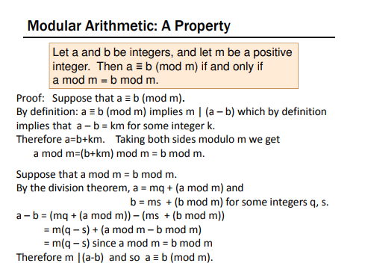

Slide 11
Congruence of Sums and Products
Theorem 5: Let m be a positive integer. If a ≡ b (mod m) and c ≡ d (mod m), then
a + c ≡ b + d (mod m) and ac ≡ bd (mod m)
Proof:
Because a ≡ b (mod m) and c ≡ d (mod m), by Theorem 4 there are integers s and t with a = b + sm and c = d + tm.
Therefore,
a + c = (b + sm) + (d + tm) = (b + d) + m(s + t) and
ac = (b + sm) (d + tm) = bd + m(bt + ds + stm).
Hence, a + c ≡ b + d (mod m) and ac ≡ bd (mod m).
Example: Because 7 ≡ 2 (mod 5) and 11 ≡ 1 (mod 5) , it follows from Theorem 5 that
18 = 7 + 11 ≡ 2 + 1 = 3 (mod 5)
77 = 7 ∙ 11 ≡ 2 ∙ 1 = 2 (mod 5)

Slide 12
Algebraic Manipulation of Congruences
Multiplying both sides of a valid congruence by an integer preserves validity.
If a ≡ b (mod m) holds then c∙a ≡ c∙b (mod m), where c is any integer, holds by Theorem 5 with d = c.
Adding an integer to both sides of a valid congruence preserves validity.
If a ≡ b (mod m) holds then c + a ≡ c + b (mod m), where c is any integer, holds by Theorem 5 with d = c.
Dividing a congruence by an integer does not always produce a valid congruence.
Example: The congruence 14≡ 8 (mod 6) holds. But dividing both sides by 2 does not produce a valid congruence since 14/2 = 7 and 8/2 = 4, but 7≢4 (mod 6).
See Section 4.3 for conditions when division is ok.

Slide 13
Computing the mod m Function of Products and Sums
Corollary: Let m be a positive integer and let a and b be integers. Then
(a + b) (mod m) = ((a mod m) + (b mod m)) mod m
and
ab mod m = ((a mod m) (b mod m)) mod m.
(proof in text)

Slide 14
Arithmetic Modulo m
Definitions: Let Z_{m} be the set of nonnegative integers less than m: {0,1, …., m−1}
The operation +_{m} is defined as a +_{m} b = (a + b) mod m. This is addition modulo m.
The operation ∙_{m} is defined as a ∙_{m} b = (a ∙ b) mod m. This is multiplication modulo m.
Using these operations is said to be doing arithmetic modulo m.
Example: Find 7 +₁₁ 9 and 7 ∙₁₁ 9.
Solution: Using the definitions above:
7 +₁₁ 9 = (7 + 9) mod 11 = 16 mod 11 = 5
7 ∙₁₁ 9 = (7 ∙ 9) mod 11 = 63 mod 11 = 8

Slide 15
Arithmetic Modulo m
The operations +_{m} and ∙_{m} satisfy many of the same properties as ordinary addition and multiplication.
Closure: If a and b belong to Z_{m} , then a +_{m} b and a ∙_{m} b belong to Z_{m} .
Associative: If a, b, and c belong to Z_{m} , then (a +_{m} b) +_{m} c = a +_{m} (b +_{m} c) and (a ∙_{m} b) ∙_{m} c = a ∙_{m} (b ∙_{m} c).
Commutative: If a and b belong to Z_{m} , then a +_{m} b = b +_{m} a and a ∙_{m} b = b ∙_{m} a.
Identity elements: The elements 0 and 1 are identity elements for addition and multiplication modulo m, respectively.
If a belongs to Z_{m} , then a +_{m} 0 = a and a ∙_{m} 1 = a.
continued →

Slide 16
Arithmetic Modulo m
Additive inverses: If a≠ 0 belongs to Z_{m} , then m− a is the additive inverse of a modulo m and 0 is its own additive inverse.
a +_{m} (m− a ) = 0 and 0 +_{m} 0 = 0
Distributivity: If a, b, and c belong to Z_{m} , then
a ∙_{m} (b +_{m} c) = (a ∙_{m} b) +_{m} (a ∙_{m} c) and (a +_{m} b) ∙_{m} c = (a ∙_{m} c) +_{m} (b ∙_{m} c).

Slide 17
Primes and Greatest Common Divisors

Slide 18
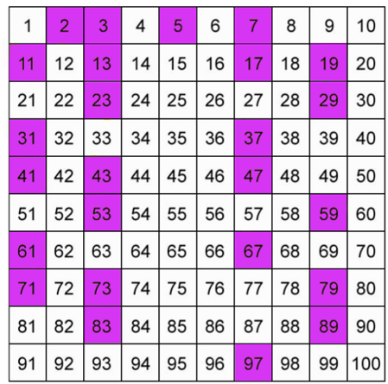
prime number
A prime number (or a prime) is a natural number greater than 1 that is not a product of two smaller natural numbers. A natural number greater than 1 that is not prime is called a composite number.
OR, A prime number is a positive integer having exactly two factors. If p is a prime, then it’s only factors are necessarily 1 and p itself. Any number which does not follow this is termed as composite numbers, which means that they can be factored into other positive integers.
Prime Numbers Chart up to 100

Slide 19
Prime Factorization
Prime factorization or integer factorization of a number is breaking a number down into the set of prime numbers which multiply together to result in the original number. This is also known as prime decomposition.
The Fundamental Theorem of Arithmetic
Theorem: Every positive integer greater than 1 can be written uniquely as a prime or as the product of two or more primes where the prime factors are written in order of non-decreasing size.
Examples of Prime Factorization
Prime factorization of 100 =
2 x 2 x 5 x 5 or 2² x 5²
Prime factorization of 76 =
2 x 2 x 19 or 2² x 19¹
Prime factorization of 228 =
2 x 2 x 3 x 19 or 2² x 3¹ x 19¹
Prime factorization of 7007 =
7 x 7 x 11 x 13 or 7² x 11¹ x 13¹
Greatest common divisor
Let a and b are integers, not both 0. Then the largest integer d such that d | a and d | b is called the greatest common divisor of a and b. The greatest common divisor is denoted as gcd(a,b).
Examples: gcd(24,36) = ?
Solution:
Here,
24 = 2 x 2 x 2 x 3
and 36 = 2 x 2 x 3 x 3
Thus, gcd(24,36) = 2 x 2 x 3 = 12

Slide 20
A systematic way to find the gcd using factorization:
Then,
Examples: gcd(24,36) = ?
Solution:
Here,
24 = 2 x 2 x 2 x 3 = 2³ x 3¹
and 36 = 2 x 2 x 3 x 3 = 2² x 3²
Thus, gcd(24,36) = 2² x 3¹ = 12
Least common multiple
Let a and b are two positive integers. The least common multiple of a and b is the smallest positive integer that is divisible by both a and b. The least common multiple is denoted as lcm(a, b).
Examples: lcm(24,36) = ?
Solution:
Here,
24 = 2 x 2 x 2 x 3
and 36 = 2 x 2 x 3 x 3
Thus, lcm(24,36) = 2 x 2 x 2 x 3 x 3 = 72

Slide 21
A systematic way to find the lcm using factorization:
Then,
$$lcm(a,b)=p_{1}^{\max{(}a_{1},b_{1})}.p_{2}^{\max{(}a_{2},b_{2})}.p_{3}^{\max{(}a_{3},b_{3})}...p_{k}^{\max{(}a_{k},b_{k})}$$
Examples: lcm(24,36) = ?
Solution:
Here,
24 = 2 x 2 x 2 x 3 = 2³ x 3¹
and 36 = 2 x 2 x 3 x 3 = 2² x 3²
Thus, lcm(24,36) = 2³ x 3² = 72
Euclidean Algorithm
This algorithm finds GCD by performing repeated division starting from the two numbers we want to find the GCD of until we get a remainder of 0.
The Euclidian algorithm is an efficient method for computing the greatest common divisor of two integers. It is based on the idea that gcd(a,b) is equal to gcd(a,c) when a > b and c is the remainder when a is divided by b.

Slide 22
Examples: Find the GCD of 190 and 34 by using Euclidean Algorithm
Solution:
Divide the larger number by the small one. In this case we divide190 by 34 to get a quotient of 5 and
remainder of 20.
Next we divide the smaller number (i.e. 34) by the remainder from the last division (i.e. 20). So 34 divide by 20, we get a quotient of 1 and remainder of 14. continue this process until we get a remainder of 0.
i.e. 190 = 5 x 34 + 20
34 = 1 x 20 + 14
20 = 1 x 14 + 6
14 = 2 x 6 + 2
6 = 3 x 2 + 0
Therefore, GCD(190, 34) = 2.
Example: Find gcd(91, 287):
Solution:
Divide 287 by 91
287 = 91 ∙ 3 + 14
91 = 14 ∙ 6 + 7
Divide 91 by 14
14 = 7 ∙ 2 + 0
Divide 14 by 7
Stopping condition

Slide 23
∴ gcd(287, 91) = gcd(91, 14) = gcd(14, 7) = 7
Example (Using the Euclidean Algorithm)
Let a = 234 and b = −42. We will use the Euclidean Algorithm to determine gcd(234, 42).
Step | Original Pair | Equation from Division Algorithm | New Pair
1 | (234, 42) | 234 = 42⋅5 + 24 | (42, 24)
2 | (42, 24) | 42 = 24⋅1 +18 | (24, 18)
3 | (24, 18) | 24 = 18⋅1 + 6 | (18, 6)
4 | (18, 6) | 18 = 6⋅3 + 0
So gcd(234, 42) = 6 and hence gcd(234, − 42) = 6.

Slide 24
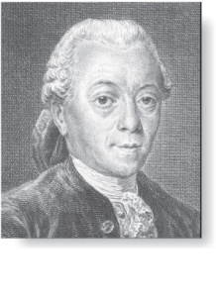
gcds as Linear Combinations
Étienne Bézout
(1730-1783)
Bézout’s Theorem: If a and b are positive integers, then there exist integers s and t such that gcd(a,b) = sa + tb.
Definition: If a and b are positive integers, then integers s and t such that gcd(a,b) = sa + tb are called Bézout coefficients of a and b. The equation gcd(a,b) = sa + tb is called Bézout’s identity.
By Bézout’s Theorem, the gcd of integers a and b can be expressed in the form sa + tb where s and t are integers. This is a linear combination with integer coefficients of a and b.
gcd(6,14) = (−2)∙6 + 1∙14

Slide 25
Note: If d = GCD(a, b) then find integer s and t such that d = s.a + t.b.
Find GCD(190, 34) by using Euclidean Algorithm
Example: Find ‘s’ and ‘t’ if GCD of 190 & 34 is 2.
i.e. 190 = 5 x 34 + 20
34 = 1 x 20 + 14
Solution:
GCD(190, 34) = 2
= 14 − 2 x 6
20 = 1 x 14 + 6
= 14 − 2 [ 20 – 1 x 14]
14 = 2 x 6 + 2
= 14 − 2 x 20 + 2 x 14
6 = 3 x 2 + 0
Therefore, GCD(190, 34) = 2.
= 3 x 14 − 2 x 20
= 3 [34 – 1 x 20] − 2 x 20
= 3 x 34 – 3 x 20 − 2 x 20
= 3 x 34 – 5 x 20
= 3 x 34 − 5 [ 190 – 5 x 34]
= 3 x 34 − 5 x 190 + 25 x 34
= − 5 x 190 + 28x 34
Its comparing with s.a + t.b.
Thus, s = − 5, t = 28.

Slide 26
Finding gcds as Linear Combinations Example: Express gcd(252,198) = 18 as a linear combination of 252 and 198.
Example: Express gcd(252,198) = 18 as a linear combination of 252 and 198.
Solution: First use the Euclidean algorithm to show gcd(252,198) = 18
252 = 1∙198 + 54
198 = 3 ∙54 + 36
54 = 1 ∙36 + 18
36 = 2 ∙18
Now working backwards, from iii and i above
18 = 54 − 1 ∙36
36 = 198 − 3 ∙54
Substituting the 2nd equation into the 1st yields:
18 = 54 − 1 ∙(198 − 3 ∙54 )= 4 ∙54 − 1 ∙198
Substituting 54 = 252 − 1 ∙198 (from i)) yields:
18 = 4 ∙(252 − 1 ∙198) − 1 ∙198 = 4 ∙252 − 5 ∙198
This method illustrated above is a two pass method. It first uses the Euclidian algorithm to find the gcd and then works backwards to express the gcd as a linear combination of the original two integers. The whole process, called the extended Euclidean algorithm

Slide 27
Euclidean Algorithm
The Euclidean algorithm expressed in pseudocode is:
procedure gcd(a, b: positive integers)
x := a
y := b
while y ≠ 0
r := x mod y
x := y
y := r
return x {gcd(a,b) is x}

Slide 28
Correctness of Euclidean Algorithm
Lemma 1: Let a = bq + r, where a, b, q, and r are integers. Then gcd(a,b) = gcd(b,r).
Proof:
Suppose that d divides both a and b. Then d also divides a − bq = r (by Theorem 1 of Section 4.1). Hence, any common divisor of a and b must also be any common divisor of b and r.
Suppose that d divides both b and r. Then d also divides bq + r = a. Hence, any common divisor of a and b must also be a common divisor of b and r.
Therefore, gcd(a,b) = gcd(b,r).

Slide 29
Extended Euclidean Algorithm( 2nd method)
Example: Find the gcd of (252,198) and the value of s and t. if gcd(a,b) = sa + tb.
Solution:
Q | A | B | R | S₁ | S₂ | S | T₁ | T₂ | T
1 | 252 | 198 | 54 | 1 | 0 | 1 | 0 | 1 | –1
3 | 198 | 54 | 36 | 0 | 1 | –3 | 1 | –1 | 4
1 | 54 | 36 | 18 | 1 | –3 | 4 | –1 | 4 | –5
2 | 36 | 18 | 0 | –3 | 4 | –11 | 4 | –5 | 14
 | 18 | 0 |  | 4 | –11 |  | –5 | 14
S = S₁– Q×S₂
T = T₁– Q×T₂
Thus gcd(252, 198) = 18 = 4×252 + (-5)198, where, s = 4,t = - 5

Slide 30
Solving Congruences

Slide 31
Linear Congruences
Definition: A congruence of the form
ax ≡ b( mod m),
where m is a positive integer, a and b are integers, and x is a variable, is called a linear congruence.
The solutions to a linear congruence ax≡ b( mod m) are all integers x that satisfy the congruence.
Definition: An integer ā such that āa ≡ 1( mod m) is said to be an inverse of a modulo m.
Example: 5 is an inverse of 3 modulo 7 since 5∙3 = 15 ≡ 1(mod 7)
One method of solving linear congruence's makes use of an inverse ā, if it exists. Although we can not divide both sides of the congruence by a, we can multiply by ā to solve for x.

Slide 32
Inverse of a modulo m
The following theorem guarantees that an inverse of a modulo m exists whenever a and m are relatively prime. Two integers a and b are relatively prime when gcd(a,b) = 1.
Theorem 1: If a and m are relatively prime integers and m > 1, then an inverse of a modulo m exists. Furthermore, this inverse is unique modulo m. (This means that there is a unique positive integer ā less than m that is an inverse of a modulo m and every other inverse of a modulo m is congruent to ā modulo m.)
Proof: Since gcd(a,m) = 1, by Theorem 6 of Section 4.3, there are integers s and t such that sa + tm = 1.
Hence, sa + tm ≡ 1 ( mod m).
Since tm ≡ 0 ( mod m), it follows that sa ≡ 1 ( mod m)
Consequently, s is an inverse of a modulo m.

Slide 33
Finding Inverses
The Euclidean algorithm and Bézout coefficients gives us a systematic approaches to finding inverses.
Example: Find an inverse of 3 modulo 7.
Solution: Because gcd(3,7) = 1, by Theorem 1, an inverse of 3 modulo 7 exists.
Using the Euclidian algorithm: 7 = 2∙3 + 1.
From this equation, we get −2∙3 + 1∙7 = 1, and see that −2 and 1 are Bézout coefficients of 3 and 7.
Hence, −2 is an inverse of 3 modulo 7.
Also every integer congruent to −2 modulo 7 is an inverse of 3 modulo 7, i.e., 5, −9, 12, etc.

Slide 34
2nd Method
Example: Find an inverse of 3 modulo 7.
Solution:
Let a be the inverse of 3, then
3×a(mod 7) = 1
Since a∈ {1, 2, 3, 4, 5, 6}
3×1(mod 7) = 3 ≠ 1
3×2(mod 7) = 6 ≠ 1
≠
3×3(mod 7) = 2 ≠ 1
3×4(mod 7) = 5 ≠ 1
3×5(mod 7) = 1
Thus, 5 is the inverse of 3 mod 7

Slide 35
Finding Inverses
Example: Find an inverse of 101 modulo 4620.
Solution: First use the Euclidian algorithm to show that gcd(101,4620) = 1.
Working Backwards:
4620 = 45∙101 + 75
101 = 1∙75 + 26
75 = 2∙26 + 23
26 = 1∙23 + 3
23 = 7∙3 + 2
3 = 1∙2 + 1
2 = 2∙1 + 0
1 = 3 − 1∙2
1 = 3 − 1∙(23 − 7∙3) = − 1 ∙23 + 8∙3
1 = −1∙23 + 8∙(26 − 1∙23) = 8∙26 − 9 ∙23
1 = 8∙26 − 9 ∙(75 − 2∙26 )= 26∙26 − 9 ∙75
1 = 26∙(101 − 1∙75) − 9 ∙75
= 26∙101 − 35 ∙75
1 = 26∙101 − 35 ∙(4620 − 45∙101)
= − 35 ∙4620 + 1601∙101
Since the last nonzero
remainder is 1,
gcd(101,4620) = 1
Bézout coefficients : − 35 and 1601
1601 is an inverse of 101 modulo 4620

Slide 36
Using Inverses to Solve Congruences
We can solve the congruence ax ≡ b( mod m) by multiplying both sides by ā.
Example: What are the solutions of the congruence 3x≡ 4( mod 7).
Solution: We found that −2 is an inverse of 3 modulo 7 . We multiply both sides of the congruence by −2 giving
−2 ∙ 3x ≡ −2 ∙ 4(mod 7).
Because −6 ≡ 1 (mod 7) and −8 ≡ 6 (mod 7), it follows that if x is a solution, then x ≡ −8 ≡ 6 (mod 7)
We need to determine if every x with x ≡ 6 (mod 7) is a solution. Assume that x ≡ 6 (mod 7). By Theorem 5 of Section 4.1, it follows that 3x ≡ 3 ∙ 6 = 18 ≡ 4( mod 7) which shows that all such x satisfy the congruence.
The solutions are the integers x such that x ≡ 6 (mod 7), namely, 6, 13, 20 … and −1, − 8, − 15,…

Slide 37
Example : Find the solutions of the linear congruence 13x ≡ 6(mod 37)
solution :
First we find gcd of 37 and 13 by Euclidian method
37 = 13(2) + 11
1 = 37(6) – 17(13)
13 = 11(1) + 2
11 = 2(5) + 1
⇒ 1 = – 17(13) (mod 37)
2 = 2(1) + 0
∴ – 17 is the inverse of 13.
Gcd(37, 13) = 1
Now,
Linear Combination:
(– 17 )13x ≡ (– 17)6(mod 37)
1 = 11 - 2(5)
⇒ x ≡ – 102 (mod 37)
1 = 11 - [13 – 11(1)](5)
1 =11(6) – 13 (5)
∴ solutions are – 102 , – 65, –28, 9, 46 ….
1 = [ 37 – 13(2)](6) – 13 (5)
1 = 37(6) – 17(13)

Slide 38

Rules for finding x in linear congruence, General format ax ≡ b(mod n)
Steps 1.
Find GCD(a,n) = d(suppose)
Steps 2.
If b/d exist, then solution of congruence is exist.
Steps 3.
Find d(modn) = r ( these no. of solution are possible.)
Steps 4.
Divide both sides by d
Steps 5.
Multiply both sides by multiplicative inverse of a
i.e. a^{– 1} ax ≡ a^{– 1} b(mod n)
Steps 6.
General solution is $x_{k}=x_{0}+k\left(\frac{n}{d}\right)$
Where, k = {0, 1, 2, …….(d – 1)}
2nd method
Example : Find the solutions of the linear congruence 9x ≡ 6(mod 15)
solution :
13x ≡ 6(mod 37)
Here, a = 13, b = 6 and n = 37.

Slide 39
Steps 1.
GCD(13,37) = 1 = d
Steps 2.
If $\frac{b}{d}=\frac{6}{1}= 6$exist, then solution of congruence is exist.
13 ×20 = 260(mod37)=1
Steps 3.
Find 1(mod37) = 1 ( therefore 1 solutions are possible.)
Steps 4.
Divide both sides by d = 1
i.e. 13x ≡ 6(mod 37)
Steps 5.
Multiply both sides by multiplicative inverse of a
i.e. 13^{– 1} 13x ≡ 13^{– 1} 6(mod 37)
⇒ 20 × 13x ≡ 20 × 6(mod 37)
i.e. multiplicative inverse of 13 is 20
⇒ x ≡ 120(mod 37)
⇒ x ≡ 9(mod 37), since 120(Mod37) = 9
∴ x₀ = 9

Slide 40
The Chinese Remainder Theorem
In the first century, the Chinese mathematician Sun-Tsu asked:
There are certain things whose number is unknown. When divided by 3, the remainder is 2; when divided by 5, the remainder is 3; when divided by 7, the remainder is 2. What will be the number of things?
This puzzle can be translated into the solution of the system of congruences:
x ≡ 2 ( mod 3),
x ≡ 3 ( mod 5),
x ≡ 2 ( mod 7)?
We’ll see how the theorem that is known as the Chinese Remainder Theorem can be used to solve Sun-Tsu’s problem.

Slide 41
The Chinese Remainder Theorem
Theorem 2: (The Chinese Remainder Theorem) Let m₁,m₂,…,m_{n} be pairwise relatively prime positive integers greater than one and a₁,a₂,…,a_{n} arbitrary integers. Then the system
x ≡ a₁ ( mod m₁)
x ≡ a₂ ( mod m₂)
∙
∙
∙
x ≡ a_{n} ( mod m_{n})
has a unique solution modulo m = m₁m₂ ∙ ∙ ∙ m_{n}.
(That is, there is a solution x with 0 ≤ x <m and all other solutions are congruent modulo m to this solution.)
continued →

Slide 42
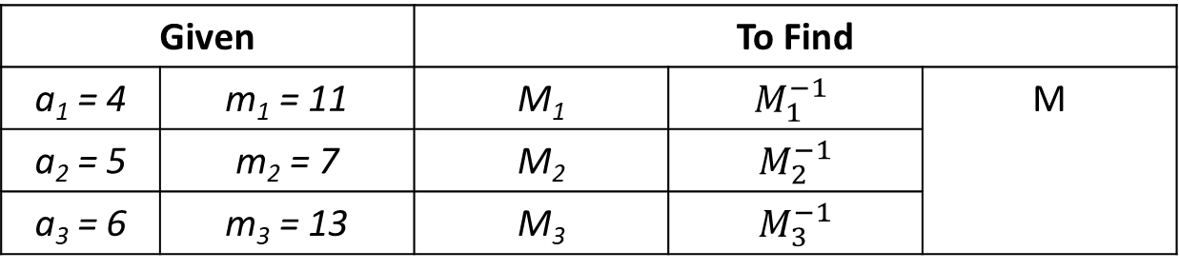
The Chinese Remainder Theorem
Example: solve the following equation using CRT
x ≡ 4 ( mod 11), x ≡ 5 ( mod 7), x ≡ 6 ( mod 13).
Solution:
x ≡ 4 ( mod 11) | x ≡ a₁ ( mod m₁)
x ≡ 5 ( mod 7) | x ≡ a₂ ( mod m₂)
x ≡ 6 ( mod 13). | x ≡ a₃ ( mod m₃)
Given |  | To Find
a₁ = 4 | m₁ = 11 | M₁ | $$M_{1}^{−1}$$ | M
a₂ = 5 | m₂ = 7 | M₂ | $M_{2}^{−1}$
a₃ = 6 | m₃ = 13 | M₃ | $M_{3}^{−1}$

Slide 43





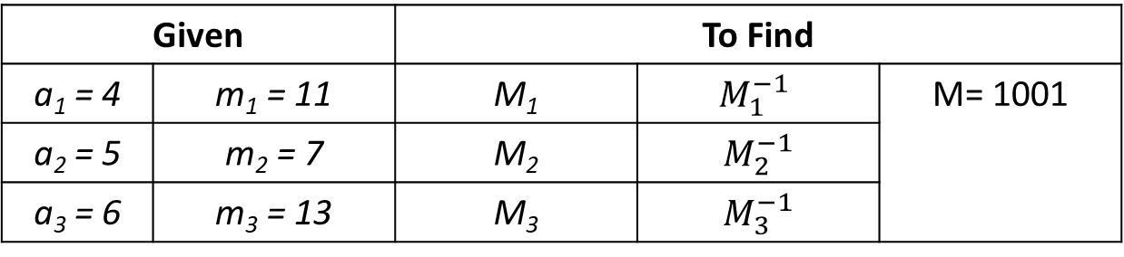








Given |  | To Find
a₁ = 4 | m₁ = 11 | M₁ | $$M_{1}^{−1}$$ | M= 1001
a₂ = 5 | m₂ = 7 | M₂ | $M_{2}^{−1}$
a₃ = 6 | m₃ = 13 | M₃ | $M_{3}^{−1}$
M = m₁ × m₂ × m₃ = 11 × 7 × 13 = 1001
M₁ = $\frac{M}{m1}$ = $\frac{1001}{11}$ = 91
M₂ = $\frac{M}{m2}$ = $\frac{1001}{7}$ = 143
M₃ = $\frac{M}{m3}$ = $\frac{1001}{13}$ = 77
M₃ × $M_{3}^{−1}$ = $1 mod \text{m}\text{3}$
M₁ × $M_{1}^{−1}$ = $1 mod \text{m}\text{1}$
M₂ × $M_{2}^{−1}$ = $1 mod \text{m}\text{2}$
⇒ 91× $M_{1}^{−1}$ = $1 mod \text{11}$
⇒ 143× $M_{2}^{−1}$ = $1 mod \text{7}$
⇒ 77 × $M_{3}^{−1}$ = $1 mod \text{13}$
${\text{} M}_{1}^{−1}$ = $4$
${\text{} M}_{2}^{−1}$ = $5$
${\text{} M}_{3}^{−1}$ = $12$
x = (a₁M₁$M_{1}^{−1}$ + a₂M₂ $M_{2}^{−1}$ + a₃M₃ $M_{3}^{−1})mod M$
= 10575 mod 1001 = 565.

Slide 44
The Chinese Remainder Theorem
To construct a solution first let M_{k}=m/m_{k} for k = 1,2,…,n and m = m₁m₂ ∙ ∙ ∙ m_{n}.
Since gcd(m_{k} ,M_{k} ) = 1, by Theorem 1, there is an integer y_{k} , an inverse of M_{k} modulo m_{k}, such that
M_{k} y_{k} ≡ 1 ( mod m_{k} ).
Form the sum
x = a₁ M₁ y₁ + a₂ M₂ y₂ + ∙ ∙ ∙ + a_{n} M_{n} y_{n} .
Note that because M_{j} ≡ 0 ( mod m_{k}) whenever j ≠k , all terms except the kth term in this sum are congruent to 0 modulo m_{k} .
Because M_{k} y_{k} ≡ 1 ( mod m_{k} ), we see that x ≡ a_{k} M_{k} y_{k} ≡ a_{k}( mod m_{k}), for k = 1,2,…,n.
Hence, x is a simultaneous solution to the n congruences.
x ≡ a₁ ( mod m₁)
x ≡ a₂ ( mod m₂)
∙
∙
∙
x ≡ a_{n} ( mod m_{n})

Slide 45
The Chinese Remainder Theorem
Example: Consider the 3 congruences from Sun-Tsu’s problem:
x ≡ 2 ( mod 3), x ≡ 3 ( mod 5), x ≡ 2 ( mod 7).
Let m = 3∙ 5 ∙ 7 = 105, M₁ = m/3 = 35, M₂ = m/5 = 21, M₃ = m/7 = 15.
We see that
2 is an inverse of M₁ = 35 modulo 3 since 35 ∙ 2 ≡ 1 (mod 3)
1 is an inverse of M₂ = 21 modulo 5 since 21 ≡ 1 (mod 5)
1 is an inverse of M₃ = 15 modulo 7 since 15 ≡ 1 (mod 7)
Hence,
x = a₁M₁y₁ + a₂M₂y₂ + a₃M₃y₃
= 2 ∙ 35 ∙ 2 + 3 ∙ 21 ∙ 1 + 2 ∙ 15 ∙ 1 = 233 ≡ 23 (mod 105)
We have shown that 23 is the smallest positive integer that is a simultaneous solution.

Slide 46
Computer Arithmetic with larger integers
Suppose that m₁, m₂,...,m_{n} are pairwise relatively prime moduli and let m be their product. By the Chinese remainder theorem, we can show that an integer a with 0 ≤ a<m can be uniquely represented by the n-tuple consisting of its remainders upon division by m_{i}, i = 1, 2, ……..,n. That is we can uniquely represented a by
(a mod m_{1,} a mod m_{2, …………,} a mod m_{n)}
Example: Find the sum and product of 123648 and 423456 using integers less than 100.
Solution:
Here, a = 123648, b = 423456 and m₁ = 99, m₂ = 98, m₃ = 97
3 – tuple a = (123648 mod 99, 123648 mod 98, 123648 mod 97)
= (96, 70, 70)
3 – tuple b = (423456 mod 99, 423456 mod 98, 423456 mod 97)
= (33, 96, 51)
3 – tuple (a + b) =
(96, 70, 70) + (33, 96, 51)
= (129, 166, 121)
= (30, 68, 24)
3 – tuple (a × b) =
(96, 70, 70) × (33, 96, 51)
= (3168, 6720, 3570)
= (0, 56, 78)

Slide 47
3 – tuple (a + b) = (30, 68, 24)
To find the sum, that is the integer represented by (30, 68, 24) we need to solve the system of congruencies
x ≡ 30 ( mod 99)
x ≡ 68 ( mod 98)
x ≡ 24 ( mod 97)

Slide 48
Pseudorandom Numbers
Randomly chosen numbers are needed for many purposes, including computer simulations.
Pseudorandom numbers are not truly random since they are generated by systematic methods.
The linear congruential method is one commonly used procedure for generating pseudorandom numbers.
Four integers are needed: the modulus m, the multiplier a, the increment c, and seed x₀, with
2 ≤ a < m, 0 ≤ c < m, 0 ≤ x₀ < m.
We generate a sequence of pseudorandom numbers {x_{n}}, with 0 ≤ x_{n} < m for all n, by successively using the recursively defined function
x_{n+1} = (ax_{n} + c) mod m.
(an example of a recursive definition, discussed in Section 5.3)
If psudorandom numbers between 0 and 1 are needed, then the generated numbers are divided by the modulus, x_{n} /m.

Slide 49
Pseudorandom Numbers
Example: Find the sequence of pseudorandom numbers generated by the linear congruential method with modulus m = 9, multiplier a = 7, increment c = 4, and seed x₀ = 3.
Solution: Compute the terms of the sequence by successively using the congruence x_{n+1} = (7x_{n} + 4) mod 9, with x₀ = 3.
x₁ = 7x₀ + 4 mod 9 = 7∙3 + 4 mod 9 = 25 mod 9 = 7,
x₂ = 7x₁ + 4 mod 9 = 7∙7 + 4 mod 9 = 53 mod 9 = 8,
x₃ = 7x₂ + 4 mod 9 = 7∙8 + 4 mod 9 = 60 mod 9 = 6,
x₄ = 7x₃ + 4 mod 9 = 7∙6 + 4 mod 9 = 46 mod 9 = 1,
x₅ = 7x₄ + 4 mod 9 = 7∙1 + 4 mod 9 = 11 mod 9 = 2,
x₆ = 7x₅ + 4 mod 9 = 7∙2 + 4 mod 9 = 18 mod 9 = 0,
x₇ = 7x₆ + 4 mod 9 = 7∙0 + 4 mod 9 = 4 mod 9 = 4,
x₈ = 7x₇ + 4 mod 9 = 7∙4 + 4 mod 9 = 32 mod 9 = 5,
x₉ = 7x₈ + 4 mod 9 = 7∙5 + 4 mod 9 = 39 mod 9 = 3.
The sequence generated is 3,7,8,6,1,2,0,4,5,3,7,8,6,1,2,0,4,5,3,…
It repeats after generating 9 terms.
Commonly, computers use a linear congruential generator with increment c = 0. This is called a pure multiplicative generator. Such a generator with modulus 2³¹ − 1 and multiplier 7⁵ = 16,807 generates 2³¹ − 2 numbers before repeating.

Slide 50
Thank You

Slide 51
prime number
A prime number (or a prime) is a natural number greater than 1 that is not a product of two smaller natural numbers. A natural number greater than 1 that is not prime is called a composite number.
OR, A prime number is a positive integer having exactly two factors. If p is a prime, then it’s only factors are necessarily 1 and p itself. Any number which does not follow this is termed as composite numbers, which means that they can be factored into other positive integers.
Prime Numbers Chart up to 100

Slide 52
Prime Factorization
Prime factorization or integer factorization of a number is breaking a number down into the set of prime numbers which multiply together to result in the original number. This is also known as prime decomposition.
Examples of Prime Factorization
Prime factorization of 100 =
2 x 2 x 5 x 5 or 2² x 5²
Prime factorization of 76 =
2 x 2 x 19 or 2² x 19¹
Prime factorization of 228 =
2 x 2 x 3 x 19 or 2² x 3¹ x 19¹
Prime factorization of 7007 =
7 x 7 x 11 x 13 or 7² x 11¹ x 13¹
Greatest common divisor
Let a and b are integers, not both 0. Then the largest integer d such that d | a and d | b is called the greatest common divisor of a and b. The greatest common divisor is denoted as gcd(a,b).
Examples: gcd(24,36) = ?
Solution:
Here,
24 = 2 x 2 x 2 x 3
and 36 = 2 x 2 x 3 x 3
Thus, gcd(24,36) = 2 x 2 x 3 = 12

Slide 53
A systematic way to find the gcd using factorization:
Then,
Examples: gcd(24,36) = ?
Solution:
Here,
24 = 2 x 2 x 2 x 3 = 2³ x 3¹
and 36 = 2 x 2 x 3 x 3 = 2² x 3²
Thus, gcd(24,36) = 2² x 3¹ = 12
Least common multiple
Let a and b are two positive integers. The least common multiple of a and b is the smallest positive integer that is divisible by both a and b. The least common multiple is denoted as lcm(a, b).
Examples: lcm(24,36) = ?
Solution:
Here,
24 = 2 x 2 x 2 x 3
and 36 = 2 x 2 x 3 x 3
Thus, lcm(24,36) = 2 x 2 x 2 x 3 x 3 = 72

Slide 54
A systematic way to find the lcm using factorization:
Then,
$$lcm(a,b)=p_{1}^{\max{(}a_{1},b_{1})}.p_{2}^{\max{(}a_{2},b_{2})}.p_{3}^{\max{(}a_{3},b_{3})}...p_{k}^{\max{(}a_{k},b_{k})}$$
Examples: lcm(24,36) = ?
Solution:
Here,
24 = 2 x 2 x 2 x 3 = 2³ x 3¹
and 36 = 2 x 2 x 3 x 3 = 2² x 3²
Thus, lcm(24,36) = 2³ x 3² = 72
Euclidean Algorithm
This algorithm finds GCD by performing repeated division starting from the two numbers we want to find the GCD of until we get a remainder of 0.
Examples: Find the GCD of 190 and 34 by using Euclidean Algorithm
Solution:
Divide the larger number by the small one. In this case we divide190 by 34 to get a quotient of 5 and remainder of 20.
Next we divide the smaller number (i.e. 34) by the remainder from the last division (i.e. 20). So 34 divide by 20, we get a quotient of 1 and remainder of 14. continue this process until we get a remainder of 0.

Slide 55
i.e. 190 = 5 x 34 + 20
34 = 1 x 20 + 14
20 = 1 x 14 + 6
14 = 2 x 6 + 2
6 = 3 x 2 + 0
Therefore, GCD(190, 34) = 2.
Example (Using the Euclidean Algorithm)
Let a = 234 and b = −42. We will use the Euclidean Algorithm to determine gcd(234, 42).
Step | Original Pair | Equation from Division Algorithm | New Pair
1 | (234, 42) | 234 = 42⋅5 + 24 | (42, 24)
2 | (42, 24) | 42 = 24⋅1 +18 | (24, 18)
3 | (24, 18) | 24 = 18⋅1 + 6 | (18, 6)
4 | (18, 6) | 18 = 6⋅3 + 0
So gcd(234, 42) = 6 and hence gcd(234, − 42) = 6.

Slide 56
Note: If d = GCD(a, b) then find integer s and t such that d = s.a + t.b.
Find GCD(190, 34) by using Euclidean Algorithm
Example: Find ‘s’ and ‘t’ if GCD of 190 & 34 is 2.
i.e. 190 = 5 x 34 + 20
34 = 1 x 20 + 14
Solution:
GCD(190, 34) = 2
= 14 − 2 x 6
20 = 1 x 14 + 6
= 14 − 2 [ 20 – 1 x 14]
14 = 2 x 6 + 2
= 14 − 2 x 20 + 2 x 14
6 = 3 x 2 + 0
Therefore, GCD(190, 34) = 2.
= 3 x 14 − 2 x 20
= 3 [34 – 1 x 20] − 2 x 20
= 3 x 34 – 3 x 20 − 2 x 20
= 3 x 34 – 5 x 20
= 3 x 34 − 5 [ 190 – 5 x 34]
= 3 x 34 − 5 x 190 + 25 x 34
= − 5 x 190 + 28x 34
Its comparing with s.a + t.b.
Thus, s = − 5, t = 28.

Slide 57
Cryptography:
Cryptography is the study of conversion of plain text to ciphertext
i.e. cryptology concerned with the putting of messages into a secret or encrypted form,
The process of converting plaintext to ciphertext is said to be encryption
The process of determining the original message from the encrypted message is called decryption.
The encryption can be represented using modular arithmetic by first transforming the letters into numbers, according to the scheme, A = 0, B = 1,…, Z = 25. Encryption of a letter x by a shift 3 can be described mathematically as,
f(x) = E = (x + 3) Mod.26 0 ≤ E ≤25
Similarly, for decryption,
f(x) = D = (x – 3) Mod.26 0 ≤ D ≤25
Example: Encrypt the word ‘I LOVE YOU’.
plain text | I | L | O | V | E | Y | O | U
Numerical value | 8 | 11 | 14 | 21 | 4 | 24 | 14 | 20
(value + 3)mod.26 | 11 | 14 | 17 | 24 | 7 | 1 | 17 | 23
ciphertext | L | O | R | Y | H | B | R | X

Slide 58
Example: Decrypt the word ‘DSSOH’.
ciphertext | D | S | S | O | H
Numerical value | 3 | 18 | 18 | 14 | 7
(value – 3)mod.26 | 0 | 15 | 15 | 11 | 4
plain text | A | P | P | L | E

Slide 59
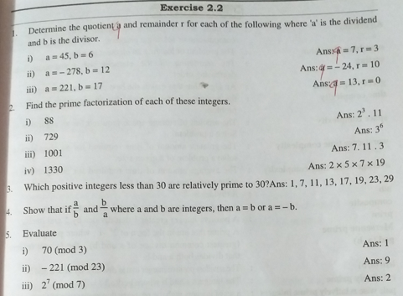
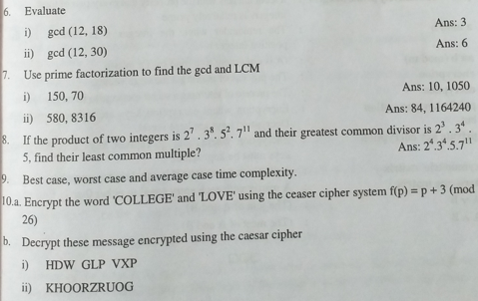

Slide 60
Thank
You

